Slide 1
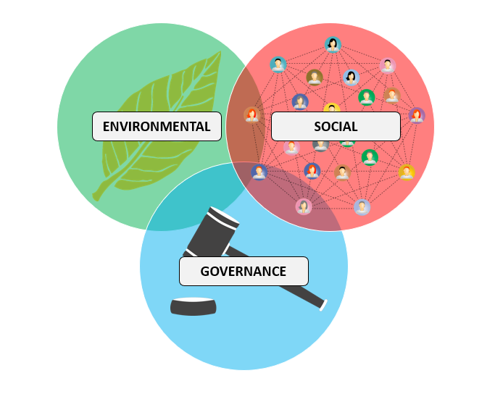
Event driven responsible investment
Pierre Quémard – 7th April 2021

Slide 2
Agenda
Why socially responsible investment ?
The visibility challenge
How solace can help
Demonstration
What’s next ?

Slide 3


Environmental and Social crisis
Pandemic accelerated adoption
Priority shift
Regulation incentive
Corona Crisis Accelerated ESG investment - source
Notes:
Since the rise of the pandemic, clear problematic of social injustice and environmental issue are facing the surface. Investors are way more regarding on the impact of their investement and not only focus on ROI In the same time a lot of new investors are flooding the market, think about the Gamestop event.

Slide 4
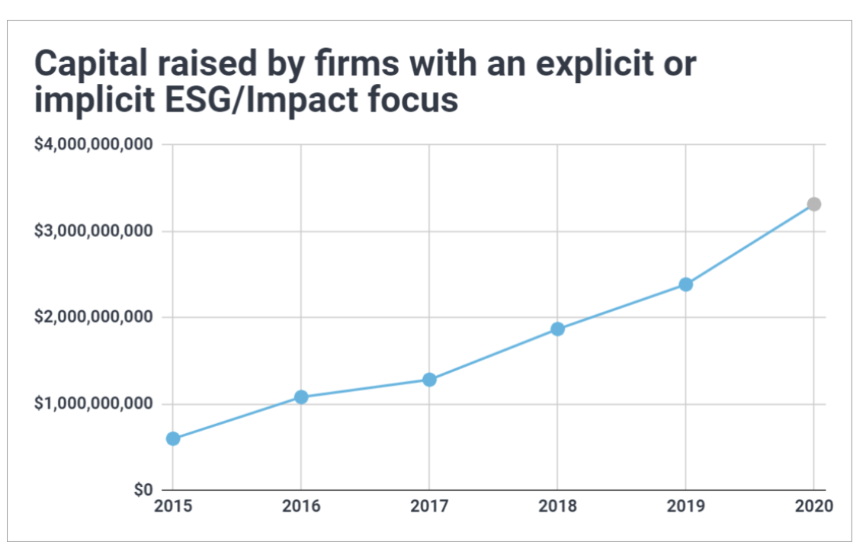
The rise of ESG
ESG outperform S&P 500 - source
Public Benefit as a viable Growth – Morgan Stanley
Source
$45.6 billion was invested in ESG investment funds in the first quarter of this year – Morning Star

Slide 5
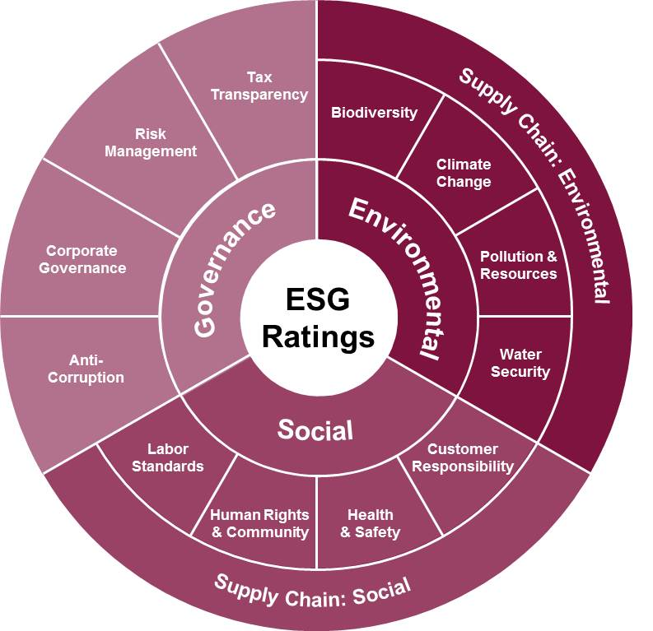
The visibility challenge
Investors demand visibility
Data is unreliable
Too many sources
Many messaging technologies
ESG Rating sources are hard to monitor – MSCI
Notes:
Coca cola story

Slide 6
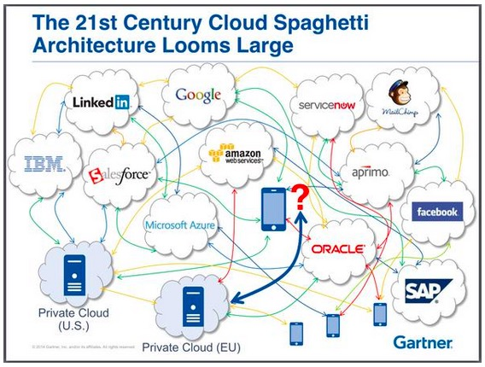
One queue to rule them all – Event Broker
Federation
Governance
Managed Service
Performance
Notes:
Federated: * Geography, Technology * Clloud, on premise
* Dynamic self-learning routing
Governance
Centralized Admin
Authenticate, Authroizate Encrypt
Monitoring
High Availability and DR
Performance
* 28 millions non-persistent and 6 millions messages/sec appliaance

Slide 7
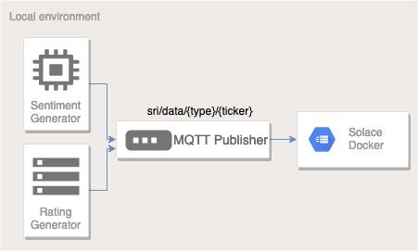



Realtime ESG Dashboard
Cloud instance of Solace on AWS
Solace Mesh Event
Dashboard connected to Solace Cloud using SMF
Notes:
Is your consumer subscribing directly to topics or a queue? Did you use topic-to-queue mapping?

Slide 8
Going beyond – Event Portal
Design and Visualize event streams and event apps
Auto-generate AsyncAPI
Protocol agnostic
Control client Access with ACL profiles
Notes:
Revamp with coca-cola, protesting voting suppression in Georgia. This can be taken into account here

Slide 9
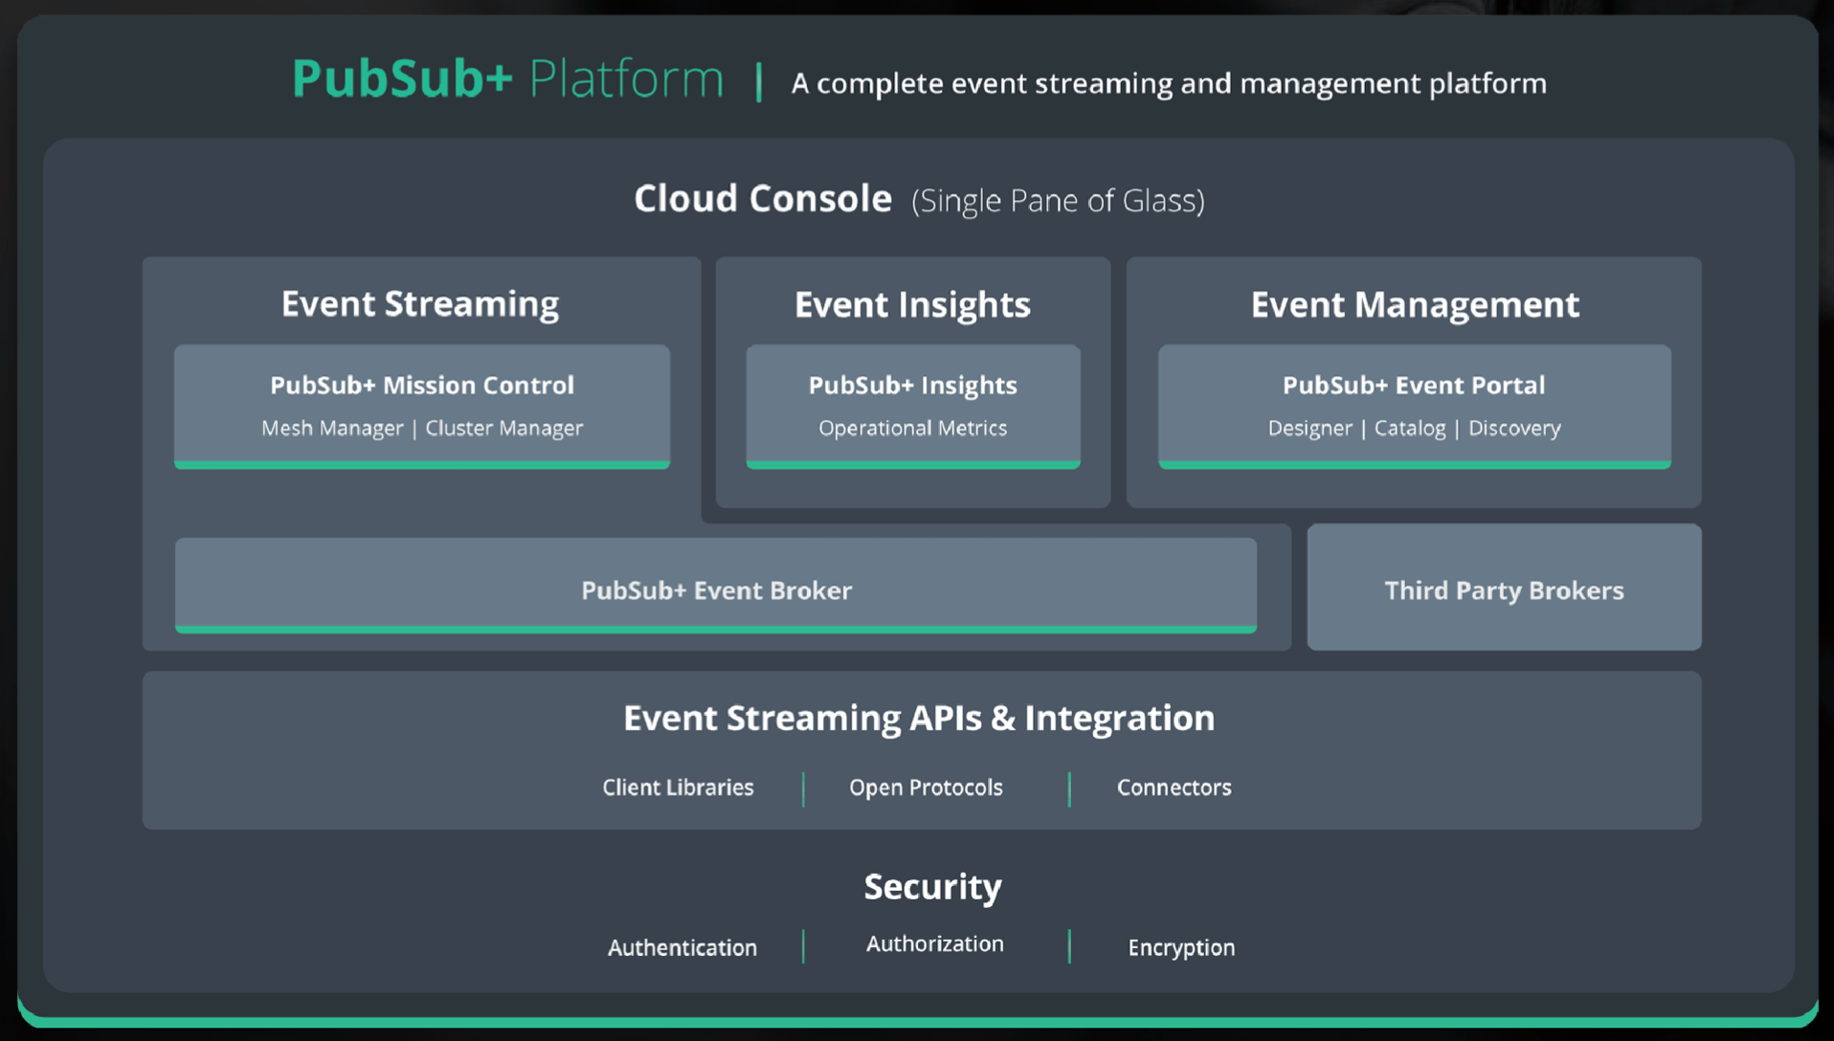
Next steps
Design
Together
Event driven data strategy for your ESG investment decision making
Notes:
As a next step I would like to help you set up a clear event driven data strategy for your ESG investment decision making.
We can start leveraging PubSub+ Event Portal and Cloud console today to aggregate data

Slide 10

Any questions ?
Try it yourself !
https://github.com/kepicorp/solace-demo

